Slide 1
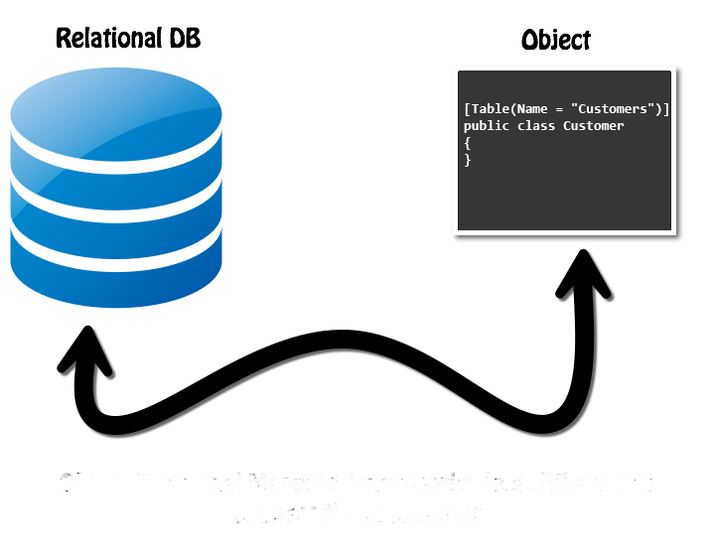
ORM Fundamentals
The ORM Concept, Config, CRUD Operations
SoftUni Team
Technical Trainers
Software University
https://about.softuni.bg/

Slide 2
Table of Contents
ORM Technologies: Basic Concepts
ORM Advantages and Disadvantages
ORM Features
Retrieving Entities from Database
Mapping Navigation Properties
Change Tracking
Generating SQL
2

Slide 3
Questions
sli.do #csharp-db

Slide 4
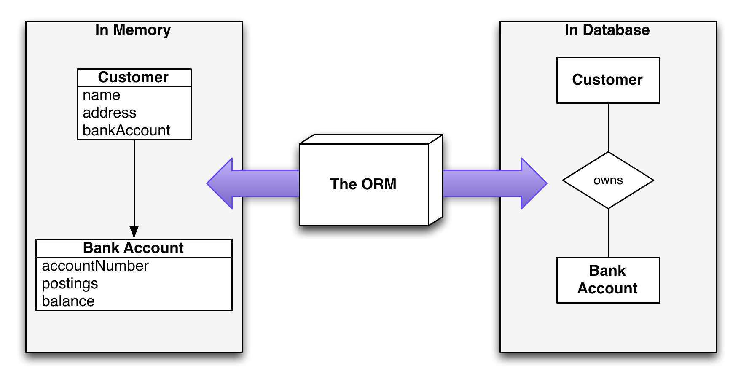
Introduction to ORM
Object-Relational Mapping

Slide 5
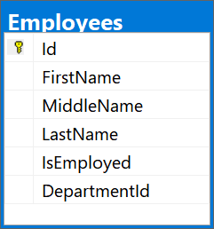
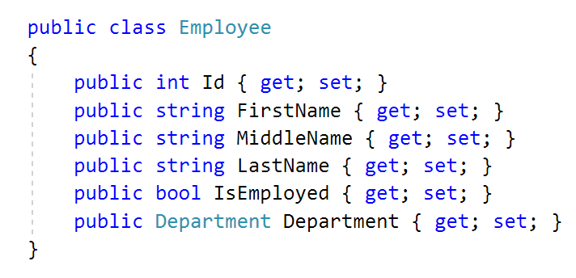
What is ORM?
Object-Relational Mapping (ORM) allows manipulating databases using common classes and objects
Database Tables ➔ C#/Java/etc. classes
5

Slide 6
ORM Frameworks: Features
ORM frameworks typically provide the following functionality:
Automatically generate SQL to perform data operations
Create object model from database schema (DB First model)
Create database schema from object model (Code First model)
Query data by object-oriented API (e.g. LINQ queries)
database.Employees.Add(new Employee
{
FirstName = "George",
LastName = "Peterson",
IsEmployed = true });
INSERT INTO Employees
(FirstName, LastName, IsEmployed)
VALUES
('George ', 'Peterson', 1)

Slide 7
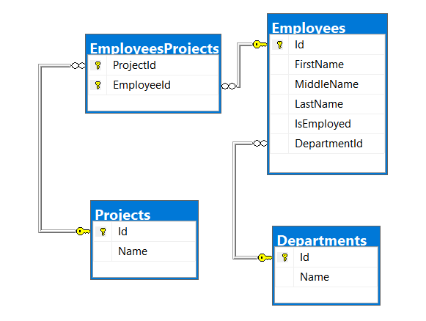
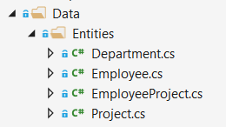
Database First Model
Database First model - models the entity classes after the database

Slide 8
Code-First Model
Code-first model - begins with classes that describe the model and then the ORM generate a database

Slide 9
ORM Advantages and Disadvantages
Object-relational mapping (ORM) advantages:
Developer productivity: writing less code
Abstract from differences between object and relational world
Manageability of the CRUD operations for complex relationships
Easier maintainability
Disadvantages:
Reduced performance (due to overhead or autogenerated SQL)
Reduces flexibility (some operations are hard to implement)

Slide 10

Entity Classes
Data Holders

Slide 11
Entity Classes
Entity classes are regular C# classes
Used for storing the data from the DB in-memory
11

Slide 12
Entity Classes: Navigation Properties (1)
Reference type properties
Point to relevant object, connected by foreign key
Set by the framework
Example: Employee's Department:
public class Employee
{
public int Id { get; set; }
...
public int DepartmentId { get; set; }
public Department Department { get; set; }
}

Slide 13
Entity Classes: Navigation Properties (2)
Navigation Properties can also be collections
Usually of type ICollection<T>
Holds all of the objects whose foreign keys are the same as the entity’s primary key
Set by the ORM framework
public class Department
{
public int Id { get; set; }
...
public ICollection<Employee> Employees { get; set; }
}

Slide 14

DbSet<T>
Specialized Collections

Slide 15
DbSet<T> Class
Generic collection with additional features
Each DbSet<T> corresponds to a single database table
Inherits from ICollection<T>
foreach-able
Supports LINQ operations
Usually several DbSets are part of a DbContext
15

Slide 16
DbSet<T> Features
Each DbSet tracks its own entities through a change tracker
Has every other feature of an ICollection<T>
Accessing the elements (LINQ)
Adding/Updating elements
Removing an entity/a range of entities
Checking for element existence
Accessing the count of elements

Slide 17

DbContext

Slide 18
DbContext Class
Holds several DbSet<T>
Responsible for populating the DbSets
Users create a DbContext, which inherits from DbContext
Using one DbSet per database table
public class SoftUniDbContext : DbContext
{
public DbSet<Employee> Employees { get; set; }
public DbSet<Department> Departments { get; set; }
public DbSet<Project> Projects { get; set; }
public DbSet<EmployeeProject> EmployeesProjects { get; set; }
}

Slide 19

Reading Data
Querying the DB Using ORM

Slide 20
Using DbContext Class
First create instance of the DbContext:
In the constructor you can pass a database connection string
DbContext properties:
All entity classes (tables) are listed as properties
e.g. DbSet<Employee> Employees { get;}
var context = new SoftUniDbContext();

Slide 21
Reading Data with LINQ Query
Executing LINQ-to-Entities query over entity:
Employees property in the DbContext:
var context = new SoftUniDbContext()
var employees = context.Employees
.Where(e => e.JobTitle == "Design Engineer")
.ToList();
public class SoftUniDbContext : DbContext
{
public DbSet<Employee> Employees { get; }
public DbSet<Project> Projects { get; }
public DbSet<Department> Departments { get; }
}

Slide 22
Reading Data with LINQ Query
We can also use extension methods for constructing the query
Find element by ID
var context = new SoftUniDbContext()
var employees = context.Employees
.Where(c => c.JobTitle == "Design Engineering")
.Select(c => c.FirstName)
.ToList();
var context = new SoftUniEntities()
var project = context.Projects .FirstOrDefault(e => e.Id == 2);
Console.WriteLine(project.Name);

Slide 23
Change Tracking

Slide 24
Change Tracking
Each DbContext instance tracks changes made to entities
These tracked entities in turn drive the changes to the database when SaveChanges is called
Entity instances become tracked when they are:
Returned from a query executed against the database
Explicitly attached to the DbContext by Add, Attach, Update or similar methods
Detected as new entities connected to existing tracked entities
24

Slide 25
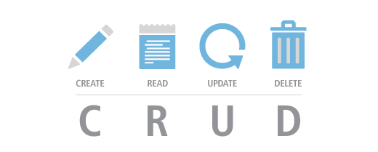
CRUD Operations

Slide 26
Creating New Entities
To create a new database row use the method Add(…) of the corresponding DbSet:
Create a new Project object
var project = new Project()
{
Name = "Judge System"
};
context.Projects.Add(project);
context.SaveChanges();
Add the object to the DbSet
Execute SQL statements
26

Slide 27
Updating Existing Entities
DbContext allows modifying entity properties and persisting them in the database
Just load an entity, modify it and call SaveChanges()
The DbContext automatically tracks all changes made on its entity objects
SELECT the first employee
Employees employee =
context.Employees.FirstOrDefault();
employees.FirstName = "Alex";
context.SaveChanges();
Execute an SQL UPDATE

Slide 28
Deleting Existing Data
Delete is done by Remove() on the specified entity collection
SaveChanges() method performs the delete action in the database
Mark the entity for deleting at the next save
Employees employee =
softUniEntities.Employees.First();
softUniEntities.Employees.Remove(employee);
softUniEntities.SaveChanges();
Execute the SQL DELETE command

Slide 29

Summary
ORM frameworks map database schema to objects in a programming language
LINQ can be used to query the DB through the DB Context
…
…
…

Slide 30
Questions?
Notes:
30

Slide 31












SoftUni Diamond Partners

Slide 32


Educational Partners

Slide 33
Trainings @ Software University (SoftUni)
Software University – High-Quality Education, Profession and Job for Software Developers
softuni.bg, about.softuni.bg
Software University Foundation
softuni.foundation
Software University @ Facebook
facebook.com/SoftwareUniversity
Software University Forums
forum.softuni.bg
33
Notes:
33

Slide 34

License
This course (slides, examples, demos, exercises, homework, documents, videos and other assets) is copyrighted content
Unauthorized copy, reproduction or use is illegal
© SoftUni – https://about.softuni.bg
© Software University – https://softuni.bg
Notes:
34

